Slide 1

2GA3 Tutorial #7
DATE: November 5th, 2021
TA: Jatin Chowdhary

Slide 2
Changes
Spend more time on tutorial questions
  i.e. More raw calculations
    Less theory, more application
Less time on review questions
  You will have to do these on your own
    Answer is provided, but don’t look at it!
Tutorial slides may be uploaded to Avenue
  BUT they’re already posted on Teams
If you have any ideas, tell me!

Slide 3
Midterm #2
Don’t slack off
It’s going to be tough
  Study hard
    Prepare now!
I can already picture everyone panicking
  It’s gonna be like flushing…
Mostly on chapter 3 & 4
Marking scheme has changed
  Best of 2
    Regardless, be well prepared!

Slide 4
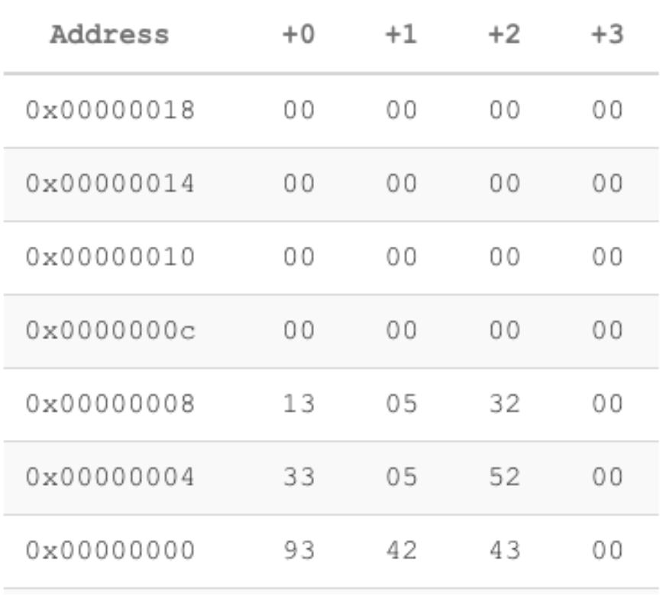
Midterm #2
Little/Big Endian will probably show up again
  Maybe not on midterm 2, but final exam
  i.e. Here is a number stored in memory, blah blah, what is it?
Question: Convert the floating point number at address 0x00000008 into its corresponding decimal number.
Show all of your work.

Slide 5
Anything about anything I just said? Or anything you just saw?

Slide 6
Homework Question #1
Question: Implementation in hardware yields better p_________, and is more e________ than software
Options:
  A) Performance, Effective
  B) Price, Efficient
  C) Performance, Efficient
  D) Price, Effective
  E) None of the above
  The answer is: C

Slide 7
Homework Question #2
Question: What does MSD stand for?
Options:
  A) Most signed digits
  B) Most signed decimals
  C) Most significant decimal
  D) Most significant dollar
  E) Most significant digit
  F) None of the above
  The answer is: E

Slide 8
Homework Question #3
Question: For a single precision floating point number (IEEE 754 format), how big is the bias?
Options:
  A) 2⁷
  B) 2⁷ – 1
  C) 2⁸
  D) 2⁸ – 1
  E) 127
  The answer is: B & E

Slide 9
Homework Question #4
Question: For a double precision floating point number in IEEE 754, how big is the bias?
Options:
  A) 2¹⁰ + 1
  B) 2¹⁰ – 1
  C) 2¹⁰
  D) 2¹⁰ + 754
  E) 2¹⁰ – 754
  The answer is: B (which evaluates to 1023)

Slide 10
Homework Question #5
Question: How big is the bias if the exponent is 24-bits wide? Assume we are using the IEEE 754 format.
Option:
  A) 2²⁴ – 1
  B) 2²⁴ + 1
  C) 2²⁴
  D) 2²³ – 1
  E) 2²³ + 1
  F) 2²³
  G) None of the above
  The answer is: D
Hint: Look at the size of the bias relative to the exponent for single and double precision floating point numbers stored in IEEE 754 format!

Slide 11
Review Question #1
Question: How does the hardware (i.e. CPU) know the difference between ints and floats in memory?
  Asked By Steven
Answer: It doesn’t!
  Everything in memory is a 0 or a 1
  The CPU does not care about the semantics of the data
    The sole job of the CPU is to carry out instructions. Period
      The CPU is not aware of what you are trying to do on a high level
  It is up to the programmer, you, to make sense of the data by specifying the type – like int, float, char, etc.
    Based on the type of the data, the compiler uses the appropriate register
      i.e. Integer VS. Floating Point

Slide 12
Review Question #2
Question: What is the difference between signed magnitude, one’s complement, two’s complement?
  Asked By Steven
Answer: All of them are ways of representing numbers – but the technique is different
  Signed Magnitude Format
    To calculate a negative number, flip the MSD to 1
      i.e. (+57)10 → (0011 1001)2
      i.e. (‒57)10 → (1011 1001)2
  One’s Complement
    To calculate a negative number, flip all the bits (or take the complement)
      i.e. (+57)10 → (0011 1001)2
      i.e. (‒57)10 → (1100 0110)2
* Assume that the binary numbers are 8-bits *

Slide 13
Review Question #2
Question: What is the difference between signed magnitude, one’s complement, two’s complement?
  Asked By Steven
Answer: All of them are ways of representing numbers – but the technique is different
  Two’s Complement
    To calculate a negative number, flip all the bits, and then add 1
      i.e. (+57)10 → (0011 1001)2
      i.e. (‒57)10 → (1100 0111)2
  In signed magnitude and one’s complement, there are 2 ways to represent 0
    In two’s complement, there’s only 1 way to represent 0
      So the ranges are different!
        ‒127 VS. ‒128
* Assume that the binary numbers are 8-bits *

Slide 14
Anything About Anything?

Slide 15
Tutorial Question #1
Question: The Hewlett-Packard 2114, 2115, and 2116 used a format with the leftmost 16 bits being the fraction stored in two’s complement format, followed by another 16-bit field which had the leftmost 8 bits as an extension of the fraction (making the fraction 24 bits long), and the rightmost 8 bits representing the exponent. However, in an interesting twist, the exponent was stored in sign-magnitude format with the sign bit on the far right! Write down the bit pattern to represent −1.5625 x 10⁻¹ assuming this format. No hidden 1 is used. Comment on how the range and accuracy of this 32-bit pattern compares to the single precision IEEE 754 standard.
Answer:
  Next slide
    (This is kind of homework)

Slide 16
Tutorial Answer #1
Precursor:
  What do we know?
    Leftmost 16-bits is the fraction
      Stored in two’s complement
    The 16-bits after the fraction are:
      Leftmost 8-bits are part of the fraction
        Fraction is 24-bits long
      Rightmost 8-bits represent the exponent
        Stored in signed magnitude format
        Sign bit on the far right
  What does it look like?
    00000000000000000000000000000000
      Fraction | Exponent | Exponent’s Sign
        Fraction = 24-bits
        Exponent = 8-bits
    The whole thing is 32-bits = (24 + 8)

Slide 17
Tutorial Answer #1
Answer:
  Using the format stated, we need to convert the following number into its bit pattern. The number is: −1.5625 × 10⁻¹
  Step 1) Align the number:
    ‒1.5625 x 10^{‒1} → ‒0.15625 x 10⁰
  Step 2) Convert to binary:
    ‒0.15625 x 10⁰ → ‒0.00101 x 2⁰
  Step 3) Move binary point two places to the right:
    ‒0.00101 x 2⁰ → ‒0.101 x 2^{‒2}
  So far, we have the fraction, exponent, and the exponent’s sign
    Remember, the format looks like this: 00000000000000000000000000000000
      Fraction = 24-bits
      Exponent = 8-bits

Slide 18
Tutorial Answer #1
Answer:
  Currently, we have: ‒0.101 x 2^{‒2}
    Now, we need to convert what we have into the format listed in the question
  Step 4) Fraction = ‒0.101
    There is no hidden 1
    ‒0.101 is stored in two’s complement
      So, we flip the bits and add 1
        0101 → 1010 → 1011
    The fraction representation is: 1011

Slide 19
Tutorial Answer #1
Answer:
  Step 5) Exponent = ‒2
    Remember, the exponent is stored in sign magnitude format
      Rightmost bit is the sign bit
        Hence, sign = 1 (because number is negative)
    First, let’s convert (+2) into binary:
      (+2)10 → (0000 0100)2
        The rightmost bit is the sign bit
    Second, we flip the sign bit to convert (+2)10 into (‒2)10
      (0000 0100)2 → (0000 0101)2
        We flip the sign bit from 0 to 1, to get a negative number
    The exponent representation: 0000 0101
      Sticking with our color codes, the number is: (0000 0101)2

Slide 20
Tutorial Answer #1
Answer:
  Recall that the format is:
    00000000000000000000000000000000
      Fraction | Exponent | Exponent’s Sign
  Currently, we have:
    Fraction = 1011
    Exponent = 0000 0101
  Our final answer, in binary, is:
    1011 0000 0000 0000 0000 0000 0000 0101

Slide 21
Anything About Anything?

Slide 22
Tutorial Question #2
Question: IEEE 754-2008 contains a half precision that is only 16-bits wide. The leftmost bit is still the sign bit, the exponent is 5-bits wide and has a bias of 15, and the mantissa is 10-bits long. A hidden 1 is assumed.
Calculate ((3.984375 × 10⁻¹ + 3.4375 × 10⁻¹) + 1.771 × 10³) by hand, assuming each of the values is stored in the 16-bit half precision format. Assume 1 guard, 1 round bit, and 1 sticky bit, and round to the nearest even.
Answer:
  Next slide

Slide 23
Floating Point Problems
Precursor:
  First of all:
    Recall that operations on floating point numbers cannot be represented in a given amount of precision
      For example, how do we accurately represent ⅓ in base-2?
        We cannot! Because ⅓ repeats. Therefore, we round results
    There are many different ways of rounding
      Each method has its own use and exists for different reasons
    The goal is to round the number so the result is as ‘‘correct’’ as possible
  Second point:
    The IEEE standard uses 3 (extra) bits of less significance than the 24-bits in the Mantissa; this is for ALL precisions
      The 3 (extra) bits are: Guard (g), Round (r), Sticky (s)

Slide 24
Guard, Round, Sticky Bit
Precursor:
  What does the guard, round, and sticky bit look like?
    1.XXXXXXXXXXXXXXXXXXXXXXX g r s
      1 = Hidden bit/one
      XXXXXXXXXXXXXXXXXXXXXXX = 23-bit mantissa
        (However, for this question, the mantissa is 10-bits long)
      g = Guard bit
      r = Round bit
      s = Sticky bit
    This is the internal format for a single precision floating point value
      The guard, round, and sticky bit are extra bits; they are not officially part of the mantissa

Slide 25
Guard, Round, Sticky Bit
Precursor:
  What is the point of a guard, round, and sticky bit?
    The guard and round bits are just 2 extra bits of precision that are used in calculations
    The sticky bit indicates what is, or could be, in lesser significant bits, but is not present
      If a 1 is shifted into the sticky bit, then the sticky bit stays at 1, regardless of further shifts
      The point of a sticky bit is to determine if we have lost any precision. Essentially, the sticky bit says, ‘‘we use to have a 1 in the right bits, but we lost it at some point, hence we have lost precision’’
  Example on next slide

Slide 26
G.R.S Example
Quick Example:
Shift | Mantissa | Guard (g) | Round (r) | Sticky (s)
0 | 1.11000000000000000000100 | 0 | 0 | 0
1 | 0.11100000000000000000010 | 0 | 0 | 0
2 | 0.01110000000000000000001 | 0 | 0 | 0
3 | 0.00111000000000000000000 | 1 | 0 | 0
4 | 0.00011100000000000000000 | 0 | 1 | 0
5 | 0.00001110000000000000000 | 0 | 0 | 1
6 | 0.00000111000000000000000 | 0 | 0 | 1
7 | 0.00000011100000000000000 | 0 | 0 | 1
8 | 0.00000001110000000000000 | 0 | 0 | 1

Slide 27
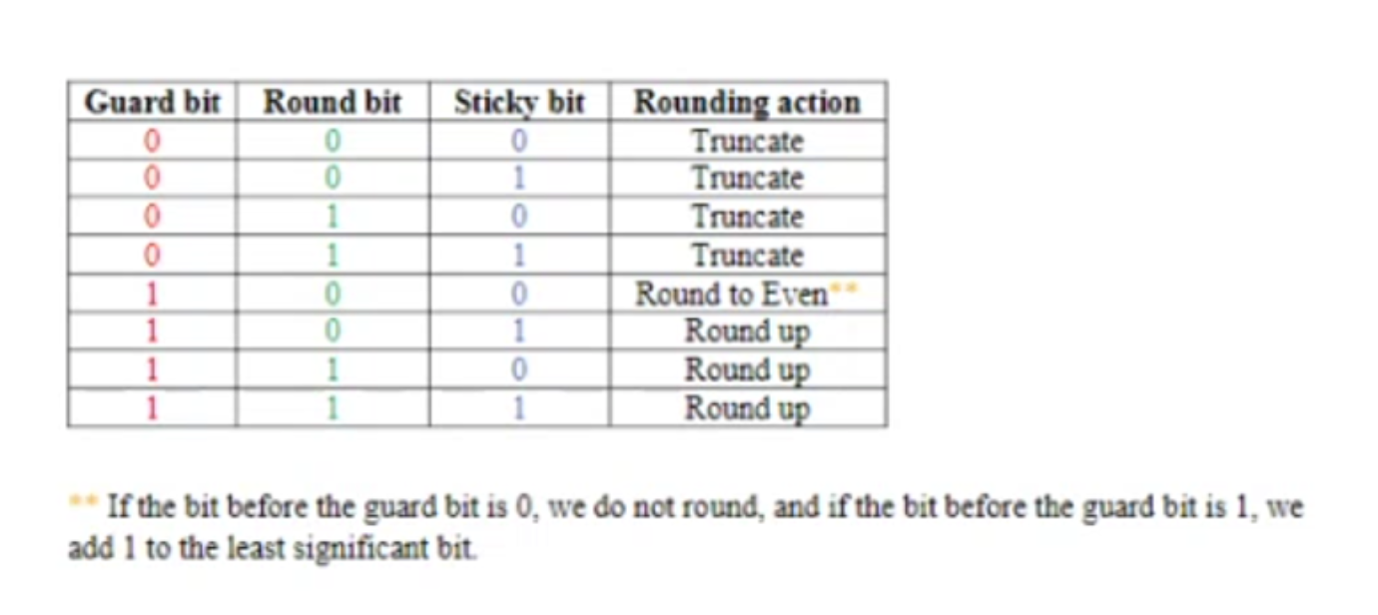
G.R.S. Rounding Rules
Mingzhe posted a table that summarizes rounding based on the Guard, Round, and Sticky bits
  Here it is:

Slide 28
G.R.S. Rounding Rules
Guard Bit | Round Bit | Sticky Bit | Action
0 | 0 | 0 | Truncate
0 | 0 | 1 | Truncate
0 | 1 | 0 | Truncate
0 | 1 | 1 | Truncate
1 | 0 | 0 | Round To Even**
1 | 0 | 1 | Round Up
1 | 1 | 0 | Round Up
1 | 1 | 1 | Round Up
** If the bit before the guard is 0, we do not round. If the bit before the guard is 1, we add 1 to the least significant bit.

Slide 29
Tutorial Answer #2
Back to the question:
  The representation is half a precision (16-bits (in total))
  Leftmost bit is the sign bit
  Exponent is 5-bits wide
    Bias of 15
  Mantissa is 10-bits
    Hidden 1 is assumed
Calculate: ((3.984375 × 10⁻¹ + 3.4375 × 10⁻¹) + 1.771 × 10³)

Slide 30
Tutorial Answer #2
Calculate ((3.984375 × 10⁻¹ + 3.4375 × 10⁻¹) + 1.771 × 10³)
  Step 1) Convert the numbers to binary
    a) 3.984375 × 10⁻¹
      First, we align the number: (3.984375 × 10⁻¹) → (0.3984375 × 10⁰)
      Then, we convert to binary: (0.3984375 × 10⁰) → (0.0110011 × 2⁰)
        Note: (0.0110011)2 = 2^{‒2} + 2^{‒3} + 2^{‒6} + 2^{‒7} = (0.3984375)10
      Finally, we normalize the number: (0.0110011 × 2⁰) → (1.10011 × 2^{‒2})
        Move the decimal point, 2 places to the right
          Exponent calculation: 0 – 2 = –2
      So, the number is: (1.10011 × 2^{‒2})
    Note: This is the IEEE-754 2008 format for half precision
      Half precision = 16-bits

Slide 31
Tutorial Answer #2
Calculate ((3.984375 × 10⁻¹ + 3.4375 × 10⁻¹) + 1.771 × 10³)
  Step 1) Convert the numbers to binary
    b) 3.4375 × 10⁻¹
      First, we align the number: (3.4375 × 10⁻¹) → (0.34375 × 10⁰)
      Then, we convert to binary: (0.34375 × 10⁰) → (0.01011 × 2⁰)
        Note: (0.01011)2 = 2^{‒2} + 2^{‒4} + 2^{‒5} = (0.34375)10
      Finally, we normalize the number: (0.011011 × 2⁰) → (1.10011 × 2^{‒2})
        Move the decimal point, 2 places to the right
          Exponent calculation: 0 – 2 = 2
      So, the number is: (1.01100 × 2^{‒2})
    Note: The logic for converting (b) is the same as the logic for converting (a)
      Once again we are converting the number into IEEE-754 2008 format

Slide 32
Tutorial Answer #2
Calculate ((3.984375 × 10⁻¹ + 3.4375 × 10⁻¹) + 1.771 × 10³)
  Step 1) Convert the numbers to binary
    c) 1.771 × 10³
      First, align the number: (1.771 × 10³) → (1771.0 × 10⁰)
      Then, convert to binary: (1771.0 × 10⁰) → (11011101011.0 × 2⁰)
        (11011101011)2 = 2⁰ + 2¹ + 2³ + 2⁵ + 2⁶ + 2⁷ + 2⁹ + 2¹⁰ = (1771)10
        Note: The number is not stored in a floating point format like IEEE-754 2008; it is stored as an integer.
      Finally, normalize the number: (11011101011.0 × 2⁰) → (1.1011101011 × 2¹⁰)
        When we normalize a number, we want it to be in the following format: a.b × y^{z}
      So, the number is: (1.1011101011 × 2¹⁰)

Slide 33
Tutorial Answer #2
Calculate ((3.984375 × 10⁻¹ + 3.4375 × 10⁻¹) + 1.771 × 10³)
  Step 2) Add the first two numbers, because they take precedence (due to the brackets)
    The calculation is: [(1.1001100000 × 2^{‒2}) + (1.0110000000 × 2^{‒2})]
(Add) | (1.1001100000) × 2^{‒2}
⁺ | (1.0110000000) × 2^{‒2}
= | (10.1111100000) × 2^{‒2}
(Normalize) = | (1.01111100000) × 2^{‒1}

Slide 34
Tutorial Answer #2
Calculate ((3.984375 × 10⁻¹ + 3.4375 × 10⁻¹) + 1.771 × 10³)
  Step 3) Add the remaining numbers (the last two numbers)
    From the previous slide we know that the first number is:
      1.01111100000 × 2^{‒1}
    The second number, to add, is:
      1.1011101011 × 2¹⁰
    The calculation is: (1.01111100000 × 2^{‒1}) + (1.1011101011 × 2¹⁰)
    Now, align the first number to look like the second number:
      (1.01111100000 × 2^{‒1}) → (0.0000000000 1 0 1 11110000 × 2¹⁰)
        Move the decimal point 11 places to the right
          Exponent calculation: ‒1 + 11 = 10
        Note:
          Guard (g) = 1
          Round (r) = 0
          Sticky (s) = 1

Slide 35
Tutorial Answer #2
Calculate ((3.984375 × 10⁻¹ + 3.4375 × 10⁻¹) + 1.771 × 10³)
  Step 3) Add the remaining numbers (the last two numbers)
    After aligning the first number, the calculation is:
    (1.1011101011 × 2¹⁰) + (0.0000000000 1 0 1 11110000 × 2¹⁰)
(Add) | 1.1011101011 × 2¹⁰
⁺ | 0.0000000000 1 0 1 11110000 × 2¹⁰
⁼ | 1.1011101011 1 0 1 11110000 × 2¹⁰
^{(Round Up)=} | 1.1011101100 × 2¹⁰

Slide 36
Tutorial Answer #2
Calculate (3.984375 × 10⁻¹ + 3.4375 × 10⁻¹) + 1.771 × 10³
  The answer, in binary, is: (1.1011101100 × 2¹⁰)
    Remember, we rounded up from:
    (1.1011101011 1 0 1 × 2¹⁰) → (1.1011101100 × 2¹⁰)
  Step 4) Convert to back to decimal
    (1.1011101100 × 2¹⁰) = (11011101100 × 2⁰)2 = (1772)10
      (11011101100 × 2⁰)2 = (2² + 2³ + 2⁵ + 2⁶ + 2⁷ +2⁹ + 2¹⁰)
  Step 5) The answer is: (1772)10

Slide 37
Tutorial Answer #2 (Bonus)
The IEEE 754-2008 format is: S EEEEE FFFFFFFFFF
  S = Sign Bit
    1 Bit
  E = Exponent
    5 Bits
  F = Fraction
    10 Bits
To represent (1772)10 in the IEEE 754-2008 format, we need its binary representation
  From the previous slide, it is: (1.1011101100 × 2¹⁰)
Now, we divide up the binary number from above to satisfy the IEEE 754-2008 format:
  Next slide

Slide 38
Tutorial Answer #2 (Bonus)
Now, we divide up the binary number to satisfy the IEEE 754-2008 format:
  Sign (Bit) = 0
    Since the number is positive, the sign bit is 0
      This is because (-1)⁰ = 1
  ExponentActual = 10
    But wait, we need to apply the bias, which is 15:
      Biased Exponent = Actual Exponent + Bias
      Biased Exponent = 10 + 15
      Biased Exponent = 25
  ExponentBiased = (25)10 = (11001)2
    Tip: Don’t forget to convert each part to its binary form
  Fraction = 1011101100
    Note: We removed the initial 1.
      This is the hidden one
    (1.1011101100) → (1011101100)

Slide 39
Tutorial Answer #2 (Bonus)
Finally, we put it all together:
  Sign = 0
  Exponent = 11001
  Fraction = 1011101100
IEEE 754-2008 format is: S ++ EEEEE ++ FFFFFFFFFF
  0 11001 1011101100
Therefore, the IEEE 754-2008 representation of (1772)10 is: 0110011011101100
  But wait, how does 0110011011101100 manage to equal 1772?
    Next slide

Slide 40
Tutorial Answer #2 (Bonus)
To go from 0110011011101100 to 1772, we need to do the following:
  (-1)^{S} × (1 + Fraction) × 2^{(Exponent − Bias)}
      Note: The (1 + ) is the hidden one – it’s back now
      Note: The bias is 15
  = (-1)⁰ × (1 + (1011101100)2) × 2^{((110011) − Bias)}
  = (1) × (1 + (1011101100)2) × 2⁽²⁵ ⁻ ¹⁵⁾
  = (1) × (1 + (1011101100)2) × 2¹⁰
  = (1) × (1 + 0.73046875) × 2¹⁰
  = (1) × (1.73046875) × 2¹⁰
  = (1772)10
1011101100 = 2⁻¹ + 2⁻³ + 2⁻⁴ + 2⁻⁵ + 2⁻⁷ + 2⁻⁸
1011101100 = 0.73046875

Slide 41
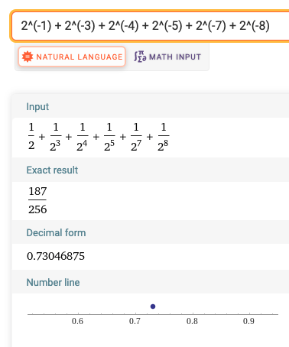
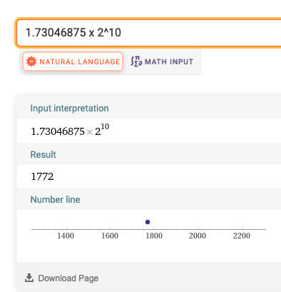
Tutorial Answer #2 (Bonus)
Proof:

Slide 42
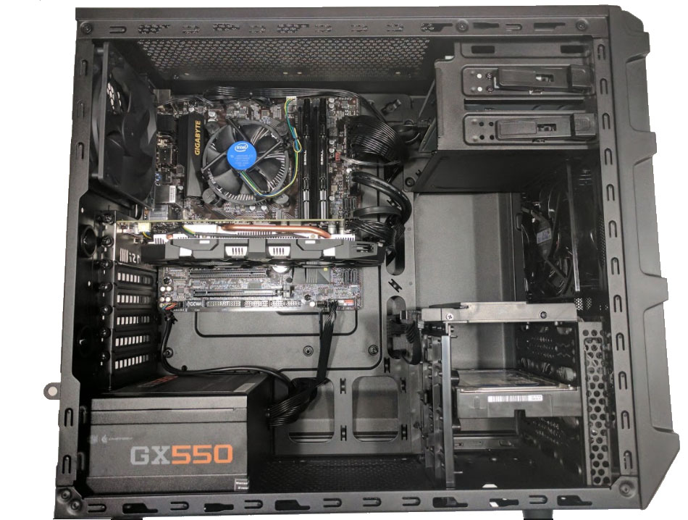
The Big Picture
This is what the inside of a desktop looks like

Slide 43
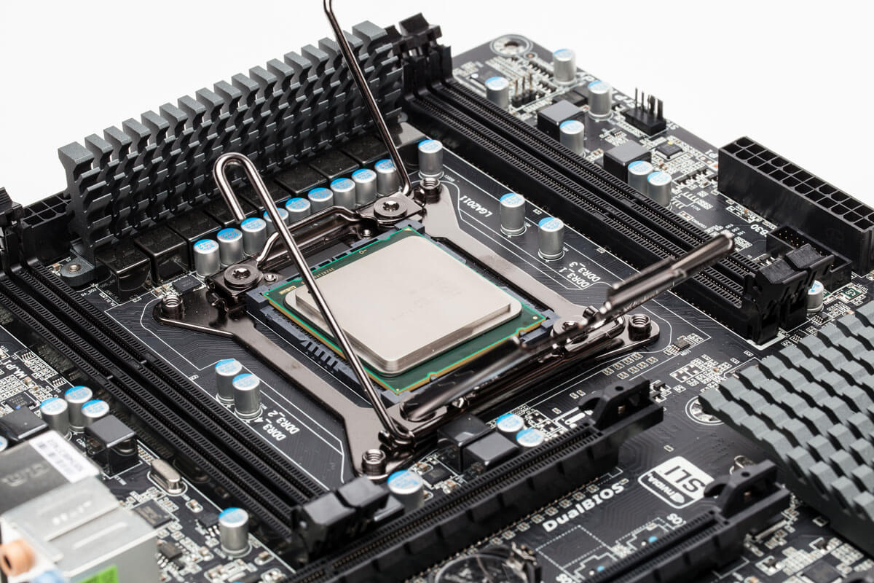
Motherboard
RAM
CPU
Motherboard

Slide 44
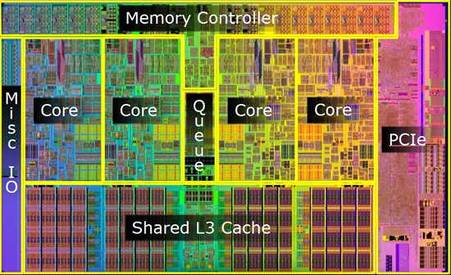
CPU Cross Section

Slide 45
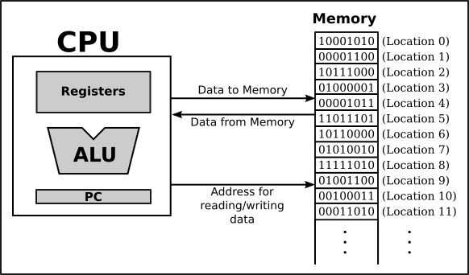
Abstract View

Slide 46
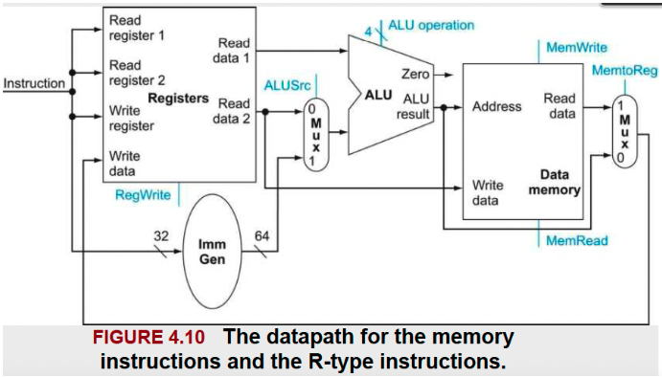
Datapath Abstract View

Slide 47
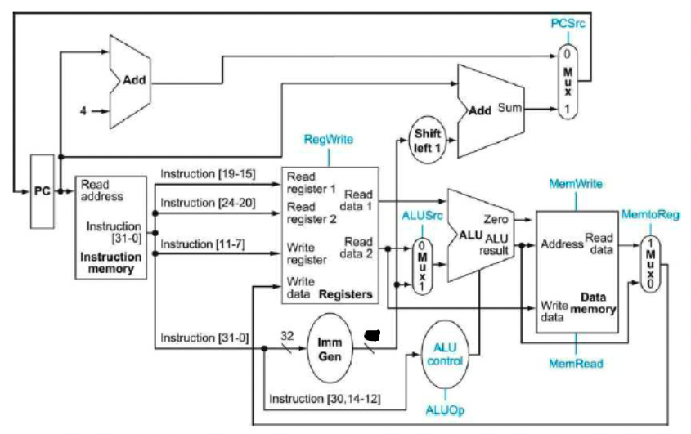
Datapath Abstract View

Slide 48
How Does It Work?
A RISC-V instruction like xori x5, x6, 4, translates to
0000 0000 0100 0011 0100 0010 1001 0011 in
machine code.
  The 0’s and 1’s are low and high voltages
    This is where the voltage difference comes from
    The more 0’s and 1’s we can shove, the faster it is
      In nerd terms, more cycles equals faster performance
  These 0’s and 1’s are sent to different parts of the Datapath for decoding/processing
So If I asked you what is a register and why do computers only understand a 0 and a 1, all of you should be able to answer this
  But do you see the big picture?
    Rather, the whole picture and how everything ties in together!

Slide 49
Instructions & Datapath
add x5, x6, x7 == 0000000 00000 00000 000 00000 0110011

Slide 50
More Details
Going based off the previous slide:
  Each part of the machine code (i.e. The bits) is sent along a different path
    Note: The colors correspond to what goes where
  The registers, x5, x6, and x7, get sent to the Registers block
    The Registers block is highlighted in red
  The calculation is performed in the ALU
    The ALU is highlighted in gray
mux stands for multiplexer
  The role of a multiplexer is to control the signals
    If a mux is given a high signal (i.e. 1), then it is ‘‘on’’ (or active)
    If a mux is given a low signal (i.e. 0), then it is ‘‘not on’’ (or inactive)

Slide 51
Tutorial Question #3
Question: Consider the following instruction and rd, rs1, rs2. The instruction is interpreted as Reg [rd] = Reg [rs1] AND Reg [rs2]. Note: The AND is logical AND.
  A) What are the values of control signals generated by the control in Figure 4.10 for this instruction?
    Figure on next slide
  B) Which resources (blocks) perform a useful function for this instruction?
  C) Which resources (blocks) produce no output for this instruction? Which resources produce output that is not used?

Slide 52
Figure 4.10

Slide 53
Tutorial Answer #3
(A) Question: What are the values of control signals generated by the control in Figure 4.10 for this instruction?
Precursor:
  First of all, what are control signals?
    In short, control signals are generated by the Control, and these signals are used to influence the behaviour of multiplexers, mux.
  So what is the question asking?
    Next slide

Slide 54
Tutorial Answer #3
Basically, the question is asking you to calculate/determine the values highlighted in yellow
    These are control signals, and they are determined by the Control

Slide 55
Tutorial Answer #3
(A) Question: What are the values of control signals generated by the control in Figure 4.10 for this instruction?
Precursor:
  With the the exception of ALUoperation, the value of the signals are either 0/1 or true/false
    ‘‘Technically’’, you can say that:
      0 = False = Low Signal
      1 = True = High Signal
  Remember, these values control the behaviour of the multiplexer
    Next slide for more information

Slide 56
Tutorial Answer #3
Let’s focus on the ALUsrc mux
    If the ALUsrc is ‘‘not activated’’, which means that a ‘‘low signal’’ is sent from the Control, then the value/data that corresponds to 0 is passed forward
    If the ALUsrc is ‘‘activated’’, which means that a ‘‘high signal’’ is sent from the Control, then the value/data that corresponds to 1 is passed forward

Slide 57
Tutorial Answer #3
(A) Question: What are the values of control signals generated by the control in Figure 4.10 for this instruction?
Precursor:
  We need to determine the values of:
    RegWrite (Are we writing to a register?)
    ALUsrc (What value is being passed forward? Read Data 2 or Imm Gen?)
    ALUoperation (What operation/instruction is being performed in the ALU?)
    MemWrite (Are we writing to memory?)
      In other words, MemWrite enables a memory write, which is used for store (i.e. sw) instructions
    MemRead (Are we reading from memory?)
      In other words, MemRead enables a memory read, which is used for load (i.e. lw) instructions)
    MemToReg (Determines where the value to be written comes from (i.e. Is the value from the ALU or from memory?))

Slide 58
Tutorial Answer #3
(A) Question: What are the values of control signals generated by the control in Figure 4.10 for this instruction?
Answer: (Fill in the table)
 | RegWrite | ALUsrc | ALU-operation | MemWrite | MemRead | MemTo-Reg
Options | True {OR} False | 0 {OR} 1 | ‘‘instruction’’ | True {OR} False | True {OR} False | 0 {OR} 1
Answer | True | 0 | ‘‘and’’ | False | False | 0

Slide 59
Tutorial Explanation #3
Explanation:
  RegWrite = True
    Yes, we are writing to a register. The and operation performs a logical AND on two values and stores the result in the destination register. Hence, we are writing to a register
      If the instruction was ‘‘sw’’, then this would be False
        If the instruction was ‘‘lw’’, then this would be True
  ALUsrc = 0
    We want the value from Read data 2 to be forwarded by the ALUsrc mux. Hence, a low signal should be passed to the ALUsrc mux by the Control
      Thus, the signal for ALUsrc is 0.
  ALUOperation = ‘‘and’’
    The operation the ALU needs to perform is logical AND. This information is inferred from the instruction.

Slide 60
Tutorial Explanation #3
Explanation:
  MemWrite = False
    Since we are only dealing with registers (i.e. rs1, rs2, rd), and we are not writing to memory, MemWrite is False
      If the instruction was store (i.e. sw), then MemWrite would be True
  MemRead = False
    Since we are only dealing with registers (i.e. rs1, rs2, rd), and we are not reading from memory, MemRead is False
      If the instruction was load (i.e. lw), then MemRead would be True
  MemToReg = 0
    Since the ‘‘and’’ instruction has nothing to do with Data memory, this value is 0
      So the MemToReg multiplexer (mux) is sent a low signal, or not activated, and the result is written back to the destination register (i.e. rd)

Slide 61
What Does It Look Like?

Slide 62
Tutorial Answer #3
(B) Question: Which resources (or blocks/chunks) perform a useful function for this instruction?
Answer: Trace through it
  Next slide

Slide 63
Tutorial Answer #3

Slide 64
Tutorial Answer #3
(B) Question: Which resources (or blocks/chunks) perform a useful function for this instruction?
Answer:
  As per the previous slide, the blocks highlighted in green are used to perform a useful function for the instruction, ‘‘and’’. These blocks are:
    Registers
    ALUsrc mux
    ALU
    MemtoReg mux

Slide 65
Tutorial Answer #3
(C) Question: Which resources (or blocks/chunks) produce no output for this instruction? Which resources produce output that is not used?
Precursor:
  We already know what blocks produce useful output
    So, the remaining blocks produce no useful output
      BUT, all blocks produce output. However, we don’t use it because it is useless
  Next slide

Slide 66
Tutorial Answer #3

Slide 67
Tutorial Answer #3
(C) Question: Which resources (or blocks/chunks) produce no output for this instruction? Which resources produce output that is not used?
Answer:
  As per the previous slide, the blocks in green produce useful output, and the blocks in red do not produce useful output
    The control signals outlined in blue are sent a high signal, and the control signals outlined in purple are sent a low signal
      The signals are sent by the Control
  i) All blocks/chunks produce output for this instruction
  ii) The outputs of Imm Gen and Data Memory are not used

Slide 68
Important Question
Question: Why have MemRead and MemToReg?
  Asked By Emily
Answer: Why have MemRead and MemToReg?
  MemRead enables a memory read for load instructions
    i.e. lw, ld, etc.
  MemToReg determines where the value to be written comes from (i.e. ALU or Memory)
    For the previous question, the value is a result from the ALU, hence the control signal for MemToReg is 0

Slide 69
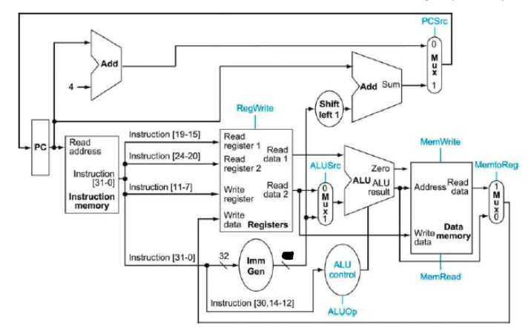
Tutorial Question #4

Slide 70
Tutorial Question #4
Question: Using the diagram on the previous slide, answer the following questions. Problems in this exercise refer to a clock cycle in which the processor fetches the following instruction word: 0x00c6aa23
  A) What is the encoded instruction?
  B) What are the values of the ALU control unit’s inputs for this instruction?
  C) What is the new PC address after this instruction is executed?
  D) For each mux, show the values of its inputs and outputs during the execution of this instruction. List values that are register outputs at Reg [xn].
  E) What are the input values for the ALU and the two add units?
  F) What are the values of all inputs for the registers unit?

Slide 71
Tutorial Answer #4
(A) Question: What is the encoded instruction?
Answer:
  Step 1) We are given a value in hex, and to get the instruction, we need to convert it into binary
    0x00c6aa23 = 0000 0000 1100 0110 1010 1010 0010 0011
  Step 2) Once we have the corresponding binary value, we look at bits [0:6] to narrow down the instruction type, and then we look at bits [12:14] to get the exact instruction
    0000 0000 1100 0110 1010 1010 0010 0011
      010 0011 tells us that the instruction can be sb, sh, or sw
      010 tells us that the instruction is sw

Slide 72
Tutorial Answer #4
(A) Question: What is the encoded instruction?
Answer:
  Step 3) Now that we know the instruction is sw, let’s divide the bit pattern as per the instruction set
    0000000 01100 01101 010 10100 0100011
      0100011 = opcode = sw
      10100 = imm[4:0] = 2² + 2⁴ = 20
      010 = funct3
      01101 = rs1 = 2⁰ + 2² + 2³ = 13
      01100 = rs2 = 2² + 2³ = 12
      0000000 = imm[11:5] = 0
  Step 4) We know that the format of an sw instruction is: sw rs2, imm(rs1)
    So, when we substitute the values, we get: sw x12, 20(x13)
      Don’t forget to add ‘x’ to indicate registers

Slide 73
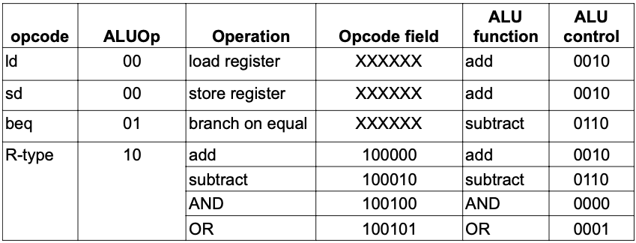
Tutorial Answer #4
(B) Question: What are the values of the ALU control unit’s inputs for this instruction?
Answer: (Refer to table below)

Slide 74
Tutorial Answer #4
(B) Question: What are the values of the ALU control unit’s inputs for this instruction?
Answer:
  We need the values for ALU control and ALUop
    According to the table on the previous slide:
      ALUop = 00
      ALU control = 0010
  Note: I got the table from Dr. Nokovic’s slides
    i.e. Slide #34 in Chapter4.pdf

Slide 75
Tutorial Answer #4
(C) Question: What is the new PC address after this instruction is executed?
Answer:
  Recall that PC stands for Program Counter
    It indicates where a computer is in its program sequence
  Since we are not jumping or branching in a store (i.e. sw) instruction, the new PC is the old PC + 4
    PCnew = PCold + 4
      The signal travels through the adder, PCsrc mux, and then back to the PC block
        The adder is where 4 is added to the PC
          See next slide

Slide 76
Program Counter Trace

Slide 77
Tutorial Answer #4
(D) Question: For each mux, show the values of its inputs and outputs during the execution of this instruction. List values that are register outputs at Reg [xn].
Answer:
  There are 3 multiplexers (mux) we need to account for
    i. ALUsrc mux
      The Control sends ALUsrc a high signal (1), because we need to send the immediate value, which is the offset, to the ALU
    ii. MemToReg mux
      The Control sends MemToReg a low signal (0), because it indicates that the value to be written to memory comes from the ALU
    iii. PCsrc mux
      The Control sends PCsrc a low signal (0), because this is a store instruction, and no branching or jumping is involved. After the store instruction is executed, we move on to the next instruction

Slide 78
Tutorial Answer #4
(D) Question: For each mux, show the values of its inputs and outputs during the execution of this instruction. List values that are register outputs at Reg [xn].
Answer: (ALUsrc mux) [Signal = High (1)]
  Inputs:
    Reg[x12] = rs2 = register 2 = read data 2
    0x00000014 = (20)10 = Immediate value
  Output
    0x00000014 = (20)10 = Immediate value
      The output is the immediate value (20)10, because the ALUsrc is sent a high signal (i.e. 1) from Control. Since we need to calculate the memory address, we need to send the base address and offset to the ALU. Hence, ALUsrc is turned on, so the ALU can compute the memory address where information needs to be stored. The ALUsrc forwards the immediate value to the ALU.

Slide 79
Tutorial Answer #4
(D) Question: For each mux, show the values of its inputs and outputs during the execution of this instruction. List values that are register outputs at Reg [xn].
Answer: (MemToReg mux) [Signal = Low (0)]
  Inputs:
    Reg[x13] + 0x00000014
      This is the location in memory (base address + offset) that we need to write to. Remember, we are storing data into memory
    <undefined>
      The value that comes from Read data is undefined
  Output
    <undefined>
      The output of the MemToReg mux is undefined, and we don’t care, because we are only interested in storing/writing the value to data memory. We are not writing to a register; there is no write back (WB).

Slide 80
Tutorial Answer #4
(D) Question: For each mux, show the values of its inputs and outputs during the execution of this instruction. List values that are register outputs at Reg [xn].
Answer: (PCsrc mux) [Signal = Low (0)]
  Inputs:
    PC + 4
      This input is the program counter plus 4; the addition is done by the adder
    PC + 0x00000028
      This input is the program counter plus the immediate value shifted left, once
        The immediate value = (0x00000014) = (20)10
          A left shift on 0x00000014 = 0x00000014 * 2 = 0x00000028
          (0x00000014) = (20)10
          (0x00000028) = (40)10
  Output
    PC + 4
      Since the Control sends the PCsrc mux a low signal (i.e. 0) , the value that is forwarded is (PC + 4)
        (PC + 4) points to 0 on the PCsrc mux
        (PC + 0x00000028) points to 1 on the PCsrc mux

Slide 81
Tutorial Answer #4
(E) Question: What are the input values for the ALU and the two add units?
Answer:
  Basically, you need to list the inputs for the following blocks:
    ALU
      The ALU takes the base address and the offset
    First Adder (Left Side)
      Takes the PC and 4 as its inputs
    Second Adder (Right Side)
      Takes the PC and immediate value shifted once as its inputs

Slide 82
Tutorial Answer #4
(E) Question: What are the input values for the ALU and the two add units?
Answer: (ALU)
  Input
    Reg[x13]
      This is the base address
    0x00000014
      This is the offset

Slide 83
Tutorial Answer #4
(E) Question: What are the input values for the ALU and the two add units?
Answer: (First Adder, Left Side)
  Input
    PC
      This is the address of the current instruction
    4
      This is added to the program counter to get to the next instruction

Slide 84
Tutorial Answer #4
(E) Question: What are the input values for the ALU and the two add units?
Answer: (Second Adder, Right Side)
  Input
    PC
      This is the address of the current instruction
    0x00000028
      This value is the immediate value multiplied by 2. It is multiplied by 2 because a logical shift is done
        (srli (0x00000014, 1)) = (0x00000028)

Slide 85
Tutorial Answer #4
(F) Question: What are the values of all inputs for the registers unit?
Answer:
  We need to look at it the Registers (file) to determine what the inputs are for the register units
    The input units for the Registers (file) are:
      Read register 1
        x13 (This is the base address)
      Read register 2
        x12 (This is the data that needs to be stored)
      Write Register
        X (Don’t care; there shouldn’t be any write backs)
      Write Data
        X (Don’t care; there shouldn’t be any write backs)
      RegWrite
        False (Since we are not writing to a register, this is false)

Slide 86
THE END

